Slide 1
Measurement Results
Date: May 12, 2019
Designed By Mohsen Hassanpourghadi

Slide 2
AMPSE Design
The design is for 6-bit, 500MHz ADC
The output of the analog part (TH-VCO):
ENOB: 5.5 Bit
SFDR: 45.7 dB
The total output of the ADC:
ENOB: 4.0 Bit
SFDR: 37.0 dB

Slide 3
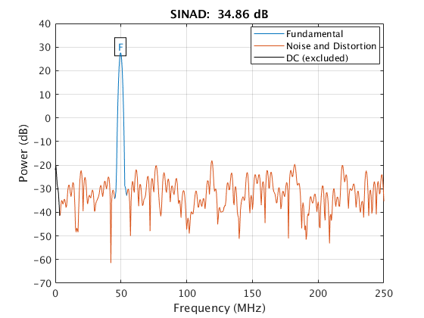
Analog output SNDR

Slide 4
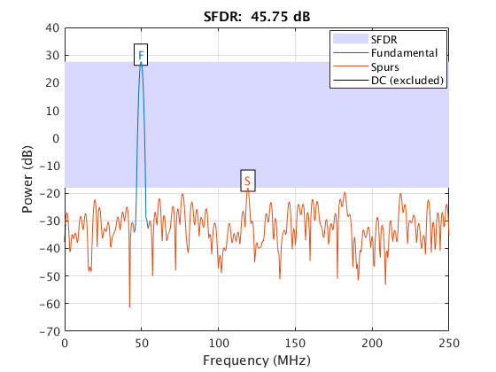
Analog output SFDR

Slide 5
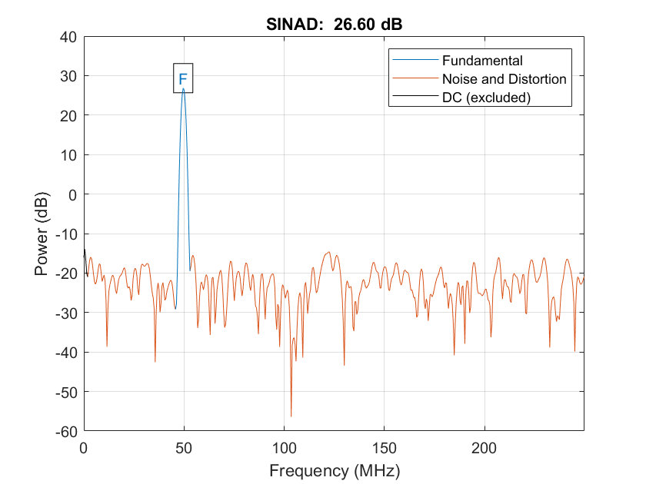
ADC Output SNDR:

Slide 6
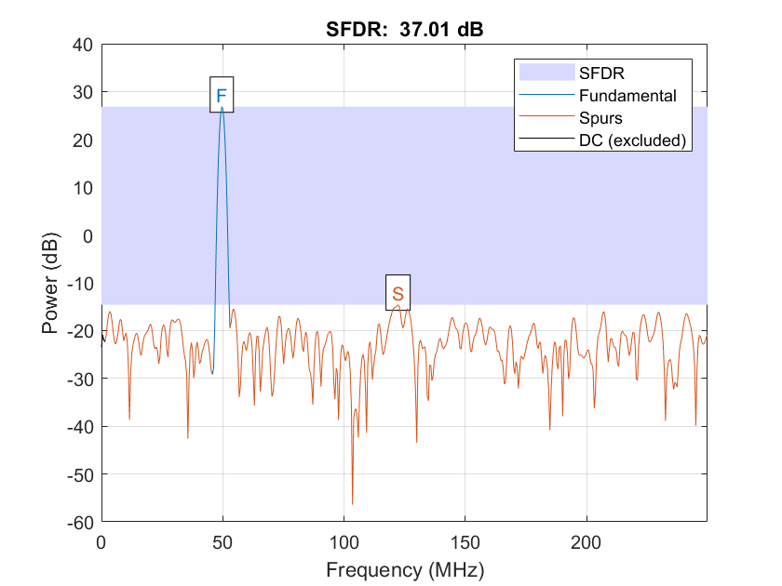
ADC Output SFDR:

